Slide 1
Guidelines to filling the information
Slide-1
Team name, name of members, short description (required)
Photos (optional)
Slide-2
Problem statement in about 100 words (required)
Assumptions (required)
Slide-3
Approach (required)
Approach description (required)
Slide-4
Details about the models (required)
Slide-5
3 screenshots of your app (required)
Link to a video showcasing your app (required)

Slide 2

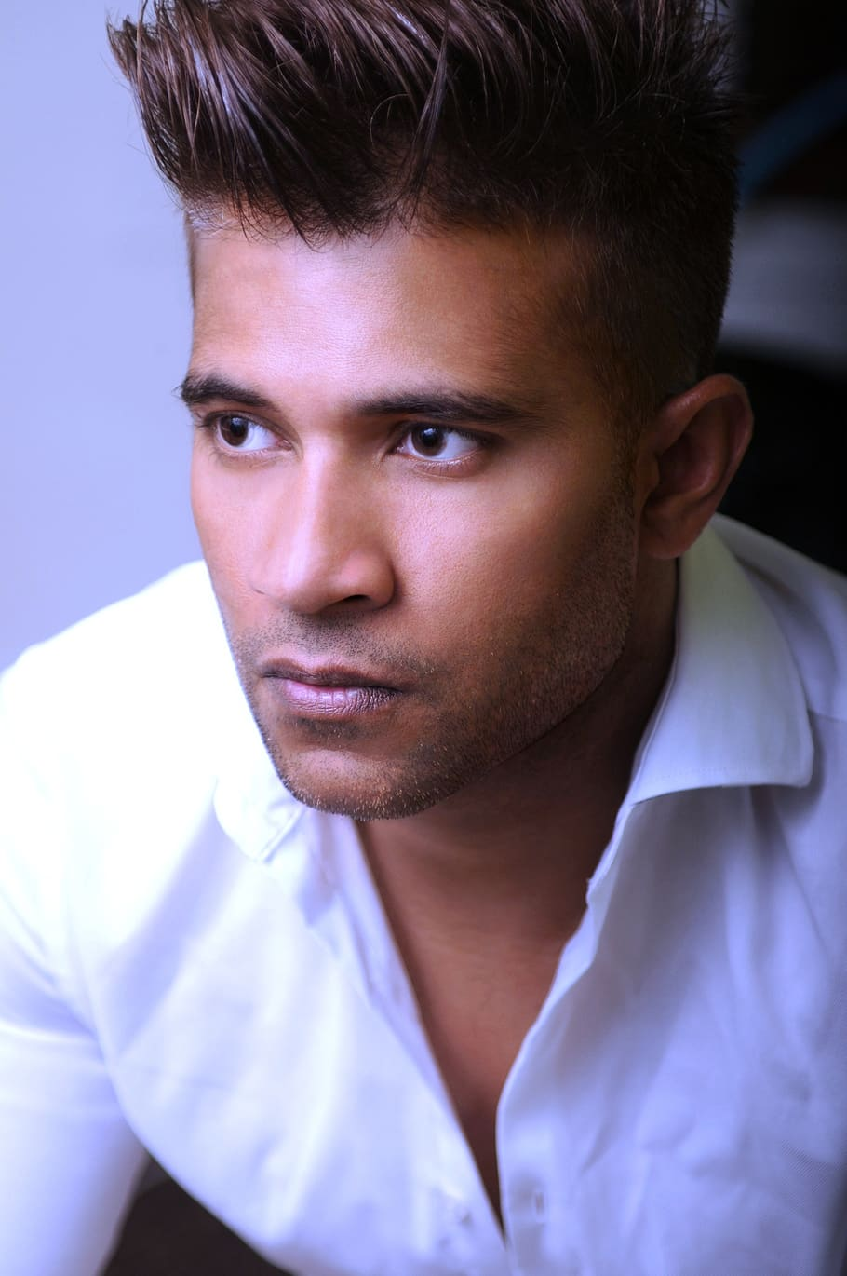
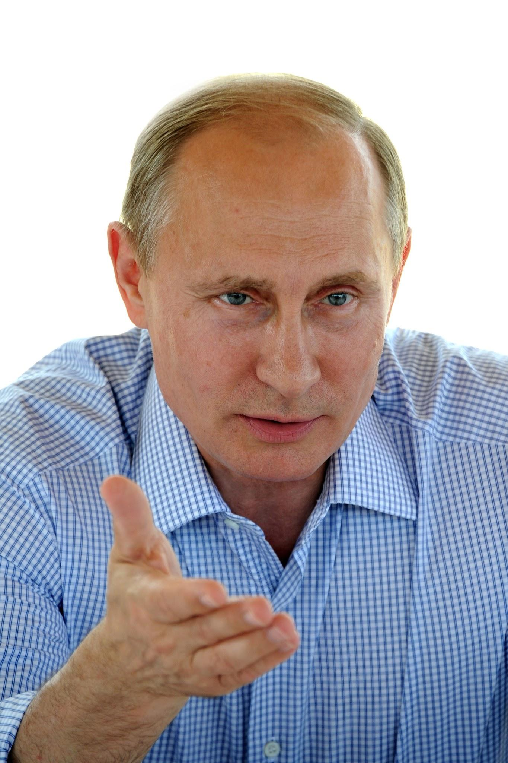

Meet The Team
Team Name
Meet the brilliant minds behind the revolutionary Crowd Estimation App, a groundbreaking solution that has transformed the way we manage and understand crowds in real-time. This exceptional team of developers, data scientists, and visionaries has come together to tackle one of the most pressing challenges of our time: optimizing crowd management and safety.
*Required
The Visionary
The Coding Maestro
The Data Guru
The Creative Genius

Slide 3
Problem Statement (short description in about 100 words)
Assumptions
In today's dynamic world, crowd management is crucial in various sectors like event planning, public safety, and urban development. However, accurately estimating real-time crowd sizes remains a challenge. We plan to create a Crowd Estimation App utilizing Video AI to offer an efficient, precise solution. This app will analyze video feeds from various sources, enabling real-time crowd size estimation. Our goal is to provide a potent tool for real-time crowd insights, facilitating improved decision-making and crowd management across diverse industries.
The image captured from the camera should not contain any motion blur.
The camera should be placed at such a height that it captures top view of the crowd (heads visible).
The system works well when there is a huge gathering of more than 200-250 people.

Slide 4
Our Approach
 | App Logic
01 | Keep running the CSR-Net on a livestream video.
02 | Estimate the count of people visible in the FOV.
03 | Overlay a heatmap for better visual representation of crowd density.
Crowd estimation app
Objective:
To estimate the size of a crowd in real-time from video feeds.
Key Features:
Video Feed Integration:
Access live video feeds from surveillance cameras or smartphones.
Crowd Counting Algorithm:
Implement a deep learning-based crowd counting algorithm.
Technology Stack:
Python, OpenCV, TensorFlow, or PyTorch for AI modeling.

Slide 5
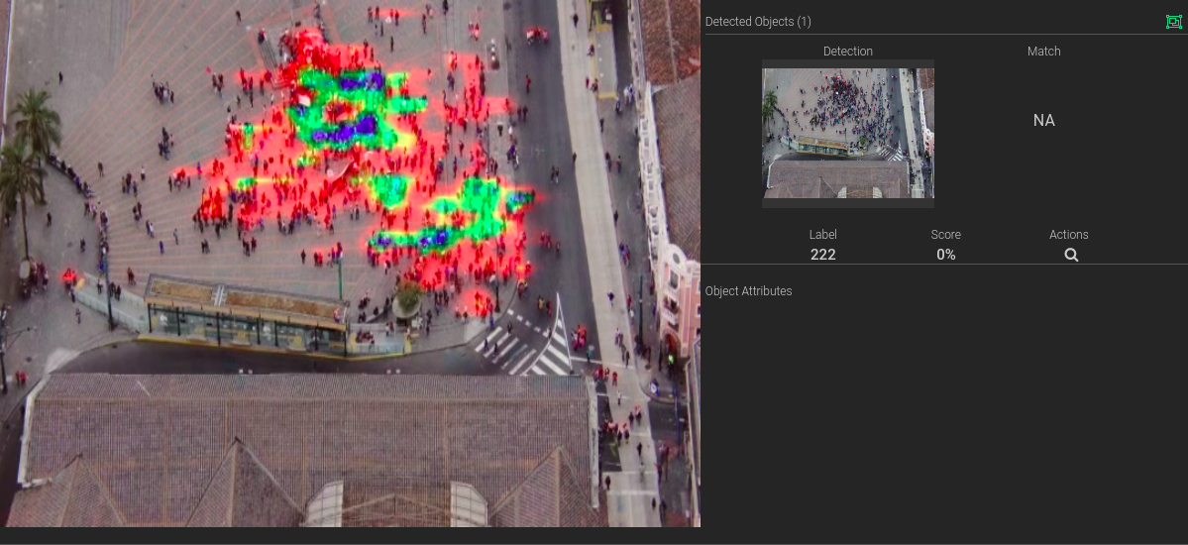
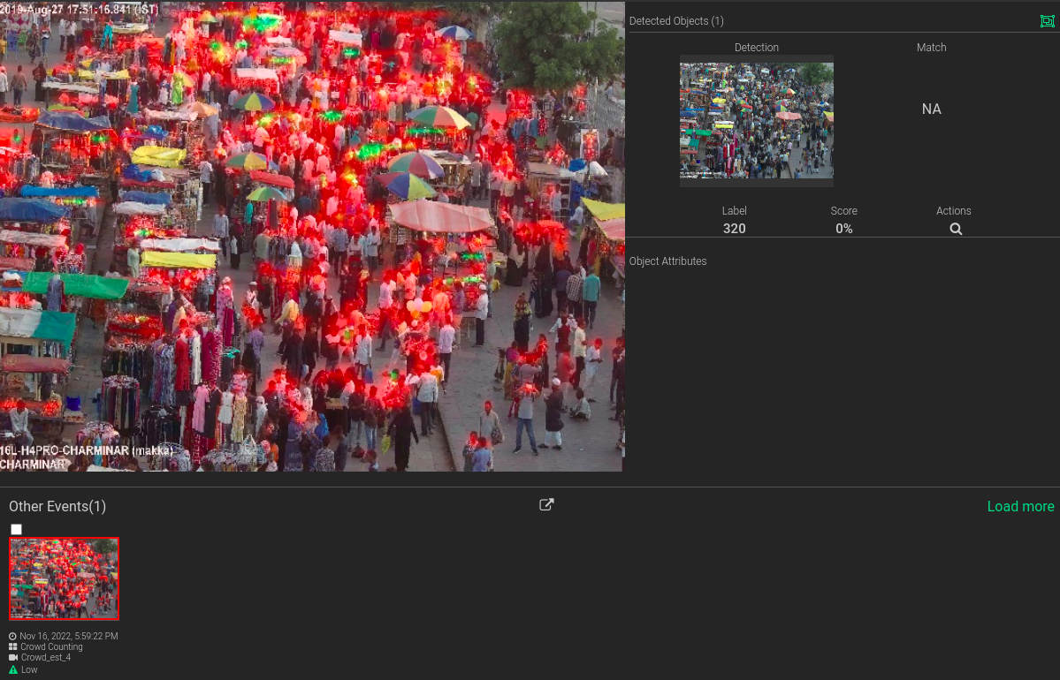
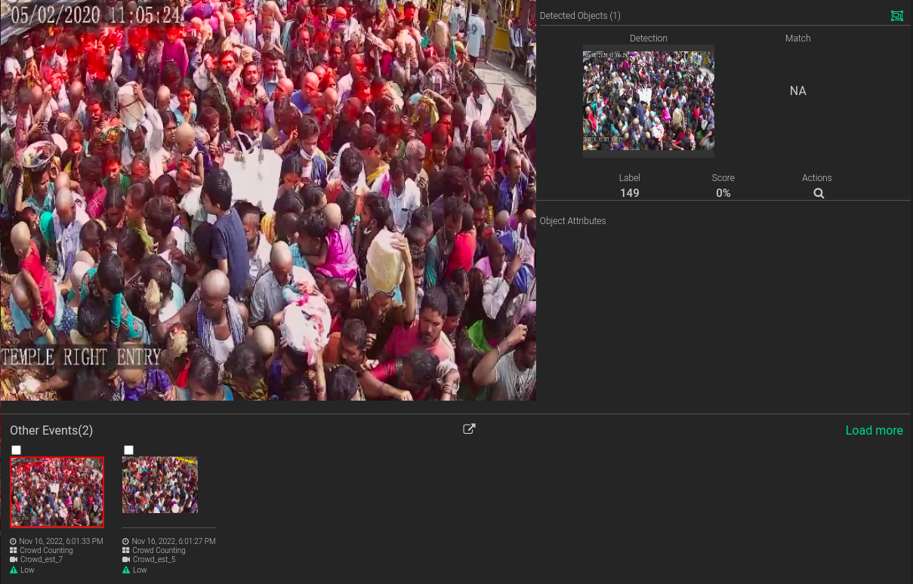
Crowd Estimation In Action
Link to the video - https://awiros775-my.sharepoint.com/:v:/g/personal/chetna_awiros_com/EZZJs7zDjrdOhWBMkR1pR8EBFgLc8k6dG6wZ3YSC9_hshw?e=V7n8mq

Slide 6
Details about the models
 | Model Name | Model Type | Framework | Input Format and Shape | Output Shape | Custom Tweaks
Primary Model Architecture | P2P-Net | Key-point estimation | PyTorch | NCHW 1 x 3 x 800 x 1024 | 1 x 93184 x 2 | NA

Slide 7
Thank You

